Slide 1
Oxford Academy & Central School District
Annual Budget Information
July 1, 2025 – June 30, 2026

Slide 2
What does this budget provide Oxford?
Maintain and Enhance UPK-12 student learning through personalized learning initiatives including college courses and various program opportunities
Maintain UPK-12 Student Intervention Programs and Special Education
Expanding on Summer Reading and Math Programs
Enhanced opportunities with the Digital Fabrication Lab and establish expansion of program into the secondary level.
Allowable reserves for unanticipated future expenses are provided for.

Slide 3
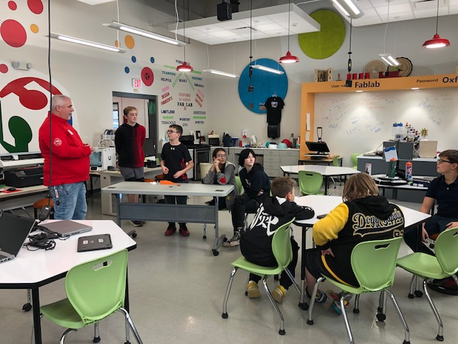
Anticipated Tax Levy for Oxford
Current Fiscal Year 24-25 Tax Levy = $5,551,337
Current Levy Calculation = 6.80% or $380,102
LEVY for Vote = 4.80% or $266,506
25-26 Tax Levy = $5,817,883
Notes:
2% Levy = $111,027
Total Current collectable Levy as Calculated = $5,931,439 1% of the levy = $55,513
6.5% = $360,837 Or total Levy of $5,912,174
5.5% = $305,324 Or total Levy of $5,856,661
4.5% = $249,810 Or total Levy of $5,801,147

Slide 4
Oxford Academy & Central School District School Tax Levy History
REAL PROPERTY TAX ITEMS | 2020-2021 | 2021-2022 | 2022-2023 | 2023-2024 | 2024-2025 | 2025-2026
 | Budget | Budget | Budget | Budget | Budget | Proposed
REAL PROPERTY TAXES BUDGET | 4,289,160 | 4,290,417 | 4,359,930 | 4,584,924 | 4,829,698 | 5,061,558
SCHOOL TAX RELIEF REIMBURSEMENTS | 819,199 | 800,743 | 830,463 | 711,588 | 721,679 | 756,325
TOTAL REAL PROPERTY TAX ITEMS | 5,108,359 | 5,091,160 | 5,190,393 | 5,296,512 | 5,551,377 | 5,817,883
Percent Change | 2.73% | -0.34% | 1.95% | 2.00% | 4.60% | 4.80%

Slide 5
Oxford Academy & Central School District School Tax Levy History
6 year Average = 2.62% to voters
6 year Average = 4.15% Calculated

Slide 6
2025-2026 Revenue Projection
 |  | 2025-2026 Revenues
 |  | 2024-2025 | 2025-2026 | 2025-2026 | 24-25 to 25-26 | Percent
 |  | Budget | Proposed | Updated State Budget | Change | Change
Sources of Funds
 | Total Miscellaneous Sources | $241,344 | $360,242 | $360,242 | $118,898 | 49.27%
State Sources
 | Total State Sources | $17,042,599 | $17,610,654 | $17,481,128 | $438,529 | 2.57%
 | Total Federal Sources | $100,000 | $100,000 | $100,000 | $0 | 0.0%
 | Total Fund Balance/Reserves | $750,000 | $143,992 | $273,518 | -$476,482 | -63.53%
 | Total Real Property Tax Items | $5,551,377 | $5,817,883 | $5,817,883 | $266,506 | 4.80%
Total Estimated Revenues |  | $23,685,320 | $24,032,771 | $24,032,771 | $347,451 | 1.47%

Slide 7
2025-26 Expenditure Projection
2025-2026 Expenditures
 |  | 2024-2025 | 2025-2026 |  | Percent
 |  | Budget | Proposed | Change | Change
Total Administrative Component |  | $2,763,042 | $2,806,319 | $43,277 | 1.57%
Total Program Component |  | $17,781,938 | $17,789,723 | $7,785 | 0.04%
Total Capital Component |  | $3,140,340 | $3,436,729 | $296,389 | 9.44%
 | Total Budget | $23,685,320 | $24,032,771 | $347,451 | 1.47%

Slide 8
Oxford Academy and Central School District
Significant known factors as of January 2025:
 |  |  |  |  | Assumptions
 |  |  |  |  | in Budget
BOCES Budget Increase |  |  |  |  | 3.95%
Rate of Inflation |  |  |  |  | 2.9%
State Aid |  |  |  |  | 5.89% 4.68% | Increase
Health Insurance Increase |  |  |  |  | 7.75%
ERS Rate – Tier 4 – 23 Members ERS Rate – Tier 6 – 44 Members TRS Rate |  |  |  |  | 19.60% 12.80% 10.25% | Employer contribution

Slide 9
Oxford Academy & Central School District Expenditure Type Summary
Oxford Academy & Central School District |  |  |  |  |  | 2024-2025 | 2025-2026
2025-2026 Budget |  |  |  |  |  |  | Proposed
Budget Account |  |  |  |  |  | Budget | Budget
Support Salaries |  |  |  |  |  | 1,834,008 | 1,839,874
Instructional Salaries |  |  |  |  |  | 6,577,259 | 6,491,862
Capital Equipment |  |  |  |  |  | 14,500 | 43,500
Contractual Services |  |  |  |  |  | 438,600 | 414,350
Utilities |  |  |  |  |  | 342,503 | 423,053
Other School Maintenance Services |  |  |  |  |  | 197,952 | 116,000
Materials and Supplies |  |  |  |  |  | 287,800 | 308,050
Categorical Aided: Textbooks, Software, & Outside Tuition |  |  |  |  |  | 72,646 | 121,000
BOCES Services |  |  |  |  |  | 4,137,955 | 4,274,431
Transportation |  |  |  |  |  | 1,152,032 | 1,002,437
Employee Benefits, Health, Retirement |  |  |  |  |  | 6,509,604 | 6,507,283
Debt Service |  |  |  |  |  | 2,070,461 | 2,415,931
Transfer to Other Funds |  |  |  |  |  | 50,000 | 75,000
 |  |  |  |  |  | 23,685,320 | 24,032,771

Slide 10
Important Dates
4/16/25 – Approve 2025-2026 Budget 4/16/25 – BOCES Budget and BOE Meeting 4/25/25 – Budget Newsletter mailed 5/13/25 – Annual Budget Information and BOE meeting 5/20/25 – Budget Vote, 12(noon)-8 pm, HS Media Center

